Slide 1
Spiritual Service
属灵的侍奉
Roman 罗马书 12:1-2

Slide 2
Roman 12:1-2 罗马书
I beseech you therefore, brethren, by the mercies of God, that ye present your bodies a living sacrifice, holy, acceptable unto God, which is your reasonable (spiritual) service and worship. And be not conformed to this world: but be ye transformed by the renewing of your mind, that ye may prove what is that good, and acceptable, and perfect, will of God. (KJV)
所以弟兄们，我以神的慈悲劝你们，将身体献上，当做活祭，是圣洁的，是神所喜悦的，你们如此侍(事）奉乃是理所当然的。 不要效法这个世界，只要心意更新而变化，叫你们察验何为神的善良、纯全、可喜悦的旨意。

Slide 3
1 Peter 2:2-3 彼得前书
as newborn babes desire earnestly the pure mental (spiritual) milk of the word, that by it ye may grow up to salvation, if indeed ye have tasted that the Lord [is] good. （Darby）
就要爱慕那纯净的灵奶，像才生的婴孩爱慕奶一样，叫你们因此渐长，以至得。 你们若尝过主恩的滋味，就必如此。

Slide 4
Present your bodies, a Living Sacrifice …
Prove the Will of God
将身体献上，当做活祭 … 叫你们察验何为神 … 的旨意
Living Sacrifice 活祭
Quality: Holy 质量： 圣洁
In God’s Perspective: Acceptable
神眼里：可喜悦
In our perspective: Reasonable, Spiritual
我们眼里：理所当然，属灵，有智慧的
Will 旨意
Good 善良，美好
Perfect 纯全
Acceptable 可喜悦

Slide 5
First Spiritual Service 第一个属灵的侍奉
Genesis 创世纪 2:16-23
耶和华神吩咐他说：“园中各样树上的果子，你可以随意吃； 只是分别善恶树上的果子，你不可吃，因为你吃的日子必定死。”
耶和华神说：“那人独居不好，我要为他造一个配偶帮助他。” … 只是那人没有遇见配偶帮助他。
耶和华神使他沉睡，他就睡了。于是取下他的一条肋骨，又把肉合起来。
耶和华神就用那人身上所取的肋骨造成一个女人，领她到那人跟前。
那人说：“这是我骨中的骨、肉中的肉！可以称她为女人，因为她是从男人身上取出来的。”

Slide 6
First Spiritual Service 第一个属灵的侍奉
Genesis 创世纪 2:16-23
Out of the ground the LORD God caused every tree to grow that is pleasing to the sight and good for food; the tree of life was also in the midst of the garden, and the tree of the knowledge of good and evil.
The LORD God commanded the man, saying, “From any tree of the garden you may freely eat; but from the tree of the knowledge of good and evil you shall not eat, for on the day that you eat from it you will certainly die.”
Then the LORD God said, “It is not good for the man to be alone; I will make him a helper suitable for him.” … but for Adam there was not found a helper suitable for him.
So the LORD God caused a deep sleep to fall upon the man, and he slept; then He took one of his ribs and closed up the flesh at that place.
And the LORD God fashioned into a woman the rib which He had taken from the man, and brought her to the man. Then the man said, “At last this is bone of my bones, and flesh of my flesh; She shall be called ‘woman,’ Because she was taken out of man.”

Slide 7
Good, Perfect, Acceptable
美好, 纯全, 可喜悦
God’s Creation 神的创造
God’s Command 神的命令和心思
  Freedom and Good 自由与美好
  Evil and Death (opposite of Freedom) 邪恶与死亡 （自由的对立面）
God’s Mind and God given spiritual power of logic 神的心思, 和神赐与的属灵逻辑的能力
  God revealed His mind to Adam and showed his what was not good
  神向亚当表明他的心思，让他知道什么是不好
  Adam understood what was not good in his mission to find the suitable helper (his service to name the animals)
  在他寻找配偶的过程里，亚当明白神的观点 (给动物起名字的事奉）
  Adam and God were in complete agreement to create this very special suitable helper
  亚当与神的观点完全认同，需要创造这个特别的配偶

Slide 8
Holy, Acceptable, and Reasonable
圣洁,可喜悦, 理所当然
The height of Adam’s spiritual service is to offer his own bodies to God as an instrument to allow God to fashion Eve out of him. (Offer bodies as a living sacrifice)
亚当灵里侍奉的高峰就是将身体成为神使用的器皿， 从他造出夏娃 （如同将身体献上当作活祭）
The height of Adam’s spiritual reasoning – Calling Eve “woman”
亚当灵里理解力的高峰就是叫夏娃“女人”
What about Eve? 夏娃呢？
if indeed ye have tasted that the Lord [is] good。 你们若尝过主恩的滋味，就必如此 （1 Peter 彼前 2:3）

Slide 9
Transforming the fallen mind
更新变化堕落的思想（心意）
Enemy attacks, lies, and casts doubts 仇敌攻击，欺骗，让人怀疑
Lost Freedom 失去自由
Bound in sin and death - merely existing not living 陷在罪与死里的人只是存在，不是活着
Transactional logic and relationship 交易性质的关系和逻辑
PPP, SSS, TTT
God Pay it all – Sinners make U-Turn
  神付清-罪人回转
God Provide in full – Saints Take from the leading of Holy Spirit
  神丰富预备 – 圣徒接受圣灵的带领
God Protects the mind – Servants Trust by faith
  神守护心思 – 仆人信靠

Slide 10
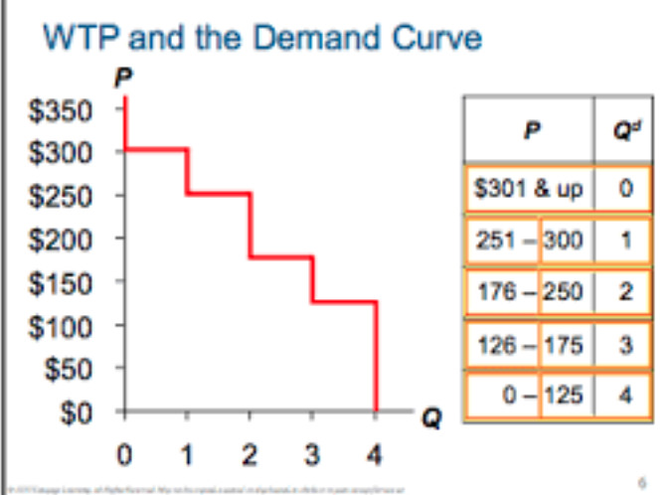

Follow Me 跟随我
Mark 10:17-26 … “Good teacher,” he asked, “what must I do to inherit eternal life?” “Why do you call me good?” Jesus answered. “No one is good—except God alone... Jesus looked at him and loved him. “One thing you lack … Then come, follow me.” At this the man’s face fell. He went away sad, because he had great wealth.
“良善的夫子，我当做什么事才可以承受永生？” 耶稣对他说：“你为什么称我是良善的？除了神一位之外，再没有良善的… 你还要来跟从我。” 他听见这话，脸上就变了色，忧忧愁愁地走了，因为他的产业很多。
WTP （Willingness To Pay 愿意出的价格）
John 21:19-22 Jesus said to him (Peter), “Follow me!” … Peter asked, “Lord, what about him?” Jesus answered, “… what is that to you? You must follow me.”
就对他说：“你跟从我吧！” 彼得转过来… 彼得看见他，就问耶稣说：“主啊，这人将来如何？” 耶稣对他说：“… 与你何干？你跟从我吧！”

Slide 11
Follow Me 跟随我
The way of Cross to build the mind of Christ in us and reverse the course a taker’s mindset and move forward gladly with to take the mind of servanthood
十字架的道路是在我们里面建立基督的心思，改变那种索取的心态，而欣然接受仆人的心思
Dealing with Disappointments 对付失望
  Disappointments in this life 今生的失望
    PRAY （Pause， Rejoice, Ask, Yield) 祷告 （停止，喜乐，求问，顺服）
    Rocks in Gilgal VS altar stones: 吉甲之石与祭坛之石
  The ultimate disappointment 最大的失望
Stay Focus - one ear 专注 彻耳
  Be real 真实: Lord’s Prayer in Gethsemane 柯西马尼园主的祷告
  Be Personal 与个人相关
  Read Psalm 25: 6 and Revelation 3:15-22

